Slide 1
Compression of Bitmap Indexes
Prof. Navneet Goyal
Department of Computer Science & Information Systems
BITS, Pilani

Slide 2
Topics
Data Compression
Run Length Encoding (RLE)
Byte-Aligned Bitmap Codes (BBC)
Word-Aligned Hybrid (WAH)

Slide 3
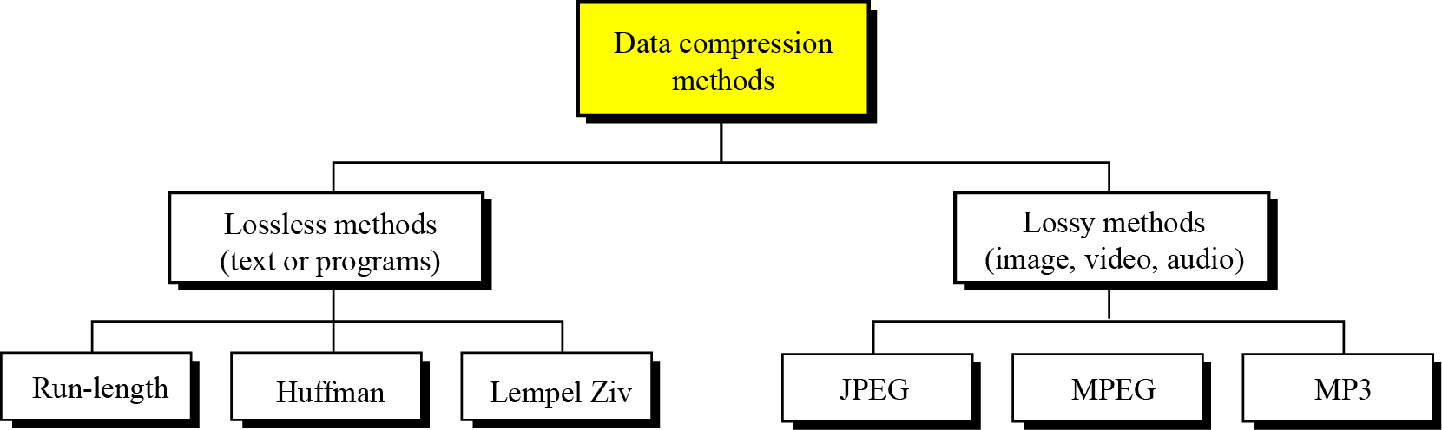
Data compression implies sending or storing a smaller number of bits. Although many methods are used for this purpose, in general these methods can be divided into two broad categories: lossless and lossy methods.
Figure 15.1 Data compression methods
Source: Chapter 15: Foundations of Computer Science © Cengage Learning

Slide 4
Run-length encoding
Run-length encoding is probably the simplest method of compression. It can be used to compress data made of any combination of symbols. It does not need to know the frequency of occurrence of symbols and can be very efficient if data is represented as 0s and 1s (therefore, suitable for Bitmap Indexes)
The general idea behind this method is to replace consecutive repeating occurrences of a symbol by one occurrence of the symbol followed by the number of occurrences.
The method can be even more efficient if one symbol is more frequent than the other in its bit pattern
Source: Chapter 15: Foundations of Computer Science © Cengage Learning

Slide 5
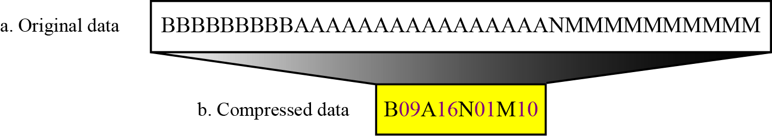
Run Length Encoding
Figure 15.2 Run-length encoding example
Source: Chapter 15: Foundations of Computer Science © Cengage Learning

Slide 6
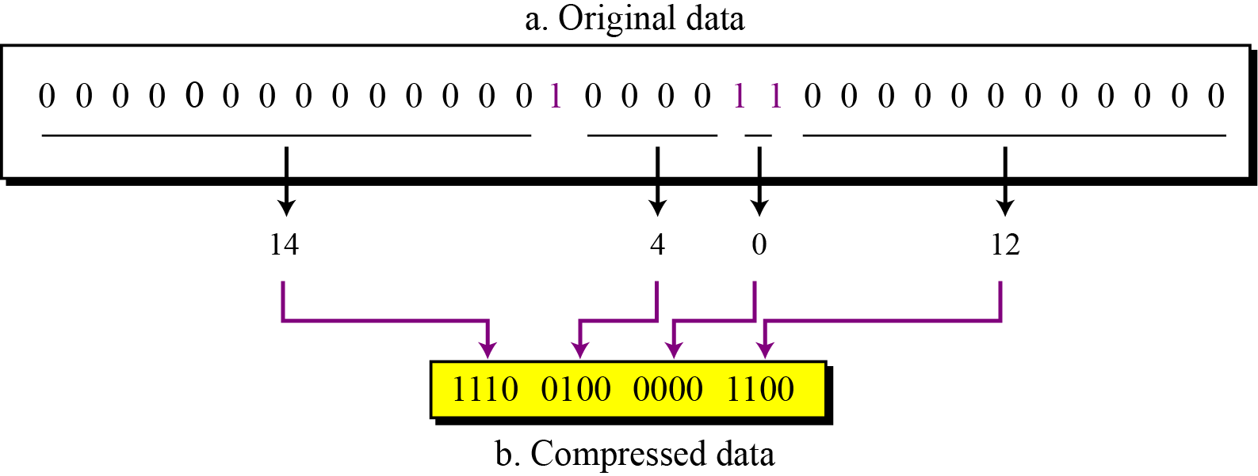
Run Length Encoding
Figure 15.3 Run-length encoding for two symbols
Source: Chapter 15: Foundations of Computer Science © Cengage Learning

Slide 7
Run Length Encoding
Attribute F (cardinality m) of a table (cardinality n)
Number of bits required to represent the bitmap on F will be mn.
If block size = 4096 bytes, then we can fit 8*4096=32,768 bits in one block
Number of blocks required = mn/32768.
This number increases with an increase in m. But as m increases the number of 1’s in any bit-vector would decrease.
Probability (bit=1)=1/m

Slide 8
Run Length Encoding
If 1’s are rare then the set of all bit-vector becomes a sparse matrix and we can encode bit-vectors so that they take much fewer than n-bits on an average.
A common encoding technique is run-length encoding (RLE)

Slide 9
Run Length Encoding
Represent a run, that is, a sequence of i 0’s followed by a 1, by some suitable binary encoding of the integer i
Concatenate the codes for each run together, and that sequence of bits represents the entire bit-vector. This is done for all bit-vectors in a bitmap

Slide 10
RLE Example
Consider the bit-vector 000101
It contains 2 runs, 001 and 01, of lengths 3 & 1 respectively
3=(11)₂ and 1=(1)₂
The run-length encoding of 000101 would become 111
The bit-vector 010001 would also be represented by 111
111 cannot be therefore decoded uniquely into one bit-vector
As a result, we cannot use binary representation of lengths for run-length encoding

Slide 11
RLE Example
Let j = number of bits in the binary representation of i
j ≈ log₂i is represented in unary by j-1 1’s and a single 0. Then we can follow the i in binary.
Consider the bit-vector 00000000000001
i=13, then j=4. Thus the encoding of i begins with 1110. We follow this by i in binary, or 1101. Thus the encoding for 13 is 11101101

Slide 12
RLE Example:
Encoding & Decoding
Encode 000101
Two runs of 3 and 1. For i=3, j=2 therefore, 0001 is encoded as 1011
For i=1, j=1 therefore, 01 is encoded as 01.
So 000101 will be encoded as 1011 01

Slide 13
RLE Example:
Encoding & Decoding
Now decode 101101
First zero at 2nd bit therefore, j=2. Next 2 bits are 11. So the first four bits are decoded as 0001.
Consider the second part. First bit is 0 therefore j=1. Next bit is 1. So the last 2 bits are decoded as 01
So 101101 is decoded to 000101
Note that every decoded bit vector will have a 1 in the last bit. Trailing zeroes can not be recovered, which can be recovered by using the cardinality of the relation
Do we need to recover trailing zeroes?

Slide 14
Example
Bitmap on AGE
25 | 1 0 0 0 0 0 0 0 1 0 0 0
30 | 0 0 0 0 0 0 0 1 0 0 0 0
45 | 0 1 0 0 0 0 0 0 0 1 0 0
50 | 0 0 1 1 1 0 0 0 0 0 1 0
60 | 0 0 0 0 0 0 0 0 0 0 0 1
70 | 0 0 0 0 0 1 0 0 0 0 0 0
85 | 0 0 0 0 0 0 1 0 0 0 0 0
Age | Salary
25 | 60
45 | 60
50 | 75
50 | 100
50 | 120
70 | 110
85 | 140
30 | 260
25 | 400
45 | 350
50 | 275
60 | 260
Bitmap on SALARY
60 | 1 1 0 0 0 0 0 0 0 0 0 0
75 | 0 0 1 0 0 0 0 0 0 0 0 0
100 | 0 0 0 1 0 0 0 0 0 0 0 0
110 | 0 0 0 0 0 1 0 0 0 0 0 0
120 | 0 0 0 0 1 0 0 0 0 0 0 0
140 | 0 0 0 0 0 0 1 0 0 0 0 0
260 | 0 0 0 0 0 0 0 1 0 0 0 0
275 | 0 0 0 0 0 0 0 0 0 0 1 0
350 | 0 0 0 0 1 0 0 0 0 1 0 0
400 | 0 0 0 0 0 0 0 0 1 0 0 0
Example taken from: Hector Garcia-Molina, JD Ullman, & J Widom, Database System Implementations, Pearson Education, 2001

Slide 15
AND/OR Operations
Decode & operate on the original bit-vectors
However, we do not need to decode entire bit-vector at once
Decode one run at a time
OR – produce a 1 whenever we encounter a 1 in either bit-vector
AND – produce a 1 iff both operands have their next 1 at the same position

Slide 16
AND/OR Operations
Age 25 1 0 0 0 0 0 0 0 1 0 0 0
Age 30 0 0 0 0 0 0 0 1 0 0 0 0
Corresponding encoded bit-vectors are 00110111 and 110111 respectively (check yourself!!)

Slide 17
AND/OR Operations
Age 25 1 0 0 0 0 0 0 0 1 0 0 0 (00110111)
OR
Age 30 0 0 0 0 0 0 0 1 0 0 0 0 (110111)
First runs of both bit-vectors are easily decoded as 0 & 7 respectively implying that first bit-vector has first 1 at position 1 & second bit-vector has first 1 at position 8 (generate 1 in position 1)
Decoding second run of Age 25, we see that the run is 7. So next 1 is at position 9.
Therefore, the bit-vector generated by OR operation is 1 followed by six 0’s, followed by 1 at 8th position coming from Age 30, and followed by 1 coming from Age 25 at position 9 100000011
Result: 1st, 8th, & 9th records are retrieved!! (Try And Yourself)

Slide 18
Operation-efficient Compression Methods
  Byte-aligned bitmap code: BBC (Antoshenkov, G.,1994, 1996)
    Uses run-length encoding
    Byte alignment, optimized for space efficiency
    Encode/decode bitmaps 8 bits (one byte) at a time
    Compresses nearly as well as LZ77 (gzip)
    Bitwise logical operations can be performed on compressed bitmaps directly
    Adopted since Oracle 7.3
  Word-aligned scheme: WAH
  (Wu et al., 2004, 2006)
    Uses run-length encoding
    Word alignment
    Designed for minimal decoding to gain speed
    Used in Lawrence Berkeley Lab for high-energy physics

Slide 19
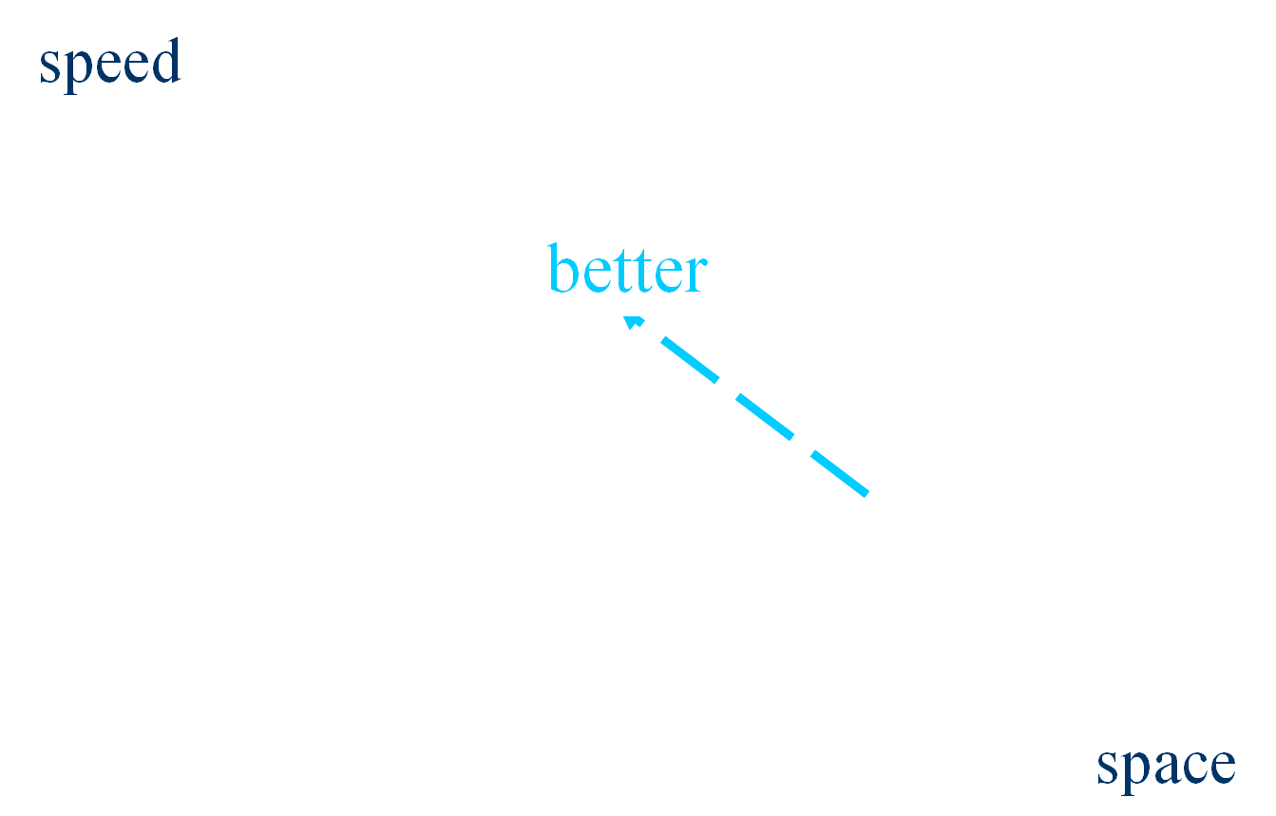
Trade-off: Compression Schemes
uncompressed
WAH
BBC
gzip
PacBits
ExpGol
Comparison of different compression Techniques
( Wu et.al, 2001)

Slide 20
Summary of Module 7
Aggregation
  Sparsity failure
  Aggregate Navigator
Partitioning
  Partitioning wrt time dimension
View Materialization
  precomputing
Bitmap Indexes

